Slide 1
PrintNet T Triple Suite
Scripting

Slide 2





Agenda
Scripting Basics
Namespaces
Script Input Module
Data Transformer Scripting
Layout Scripting
Impositioning Script
Appendix

Slide 3

1. Scripting Basics

Slide 4

First Scripts
Complex jobs simplification (no need of a large number of modules)
Non-standard methods of job processing
Scripting in ScriptInput, DataTransformer, Layout and Impositioning Script
Similar to C++
Whisper
Notes:
Object oriented scripting
Each object has its own properties and methods
Scripting in Data Transformer: Data Manipulation, followed not directly by Layout but can be by GroupBy, etc.
Scripting in Layout: Pages Overflowing, Variable Images (Sometimes the result is the same in DataTransformer and in Layout, but those are just simple operations)
Scripting in Impositioning Script: Pages Manipulation
Sample Scripts

Slide 5

First Scripts
Hello world on a page
Layout/Data/InsertVariable
Calculated
^{return “Hello world”;}
^{“Hello world”}
return DateTime.Now.toString();
Notes:
HelloWorld1.wfd
All the example introduction scripts are done in Layout
Sample Scripts

Slide 6
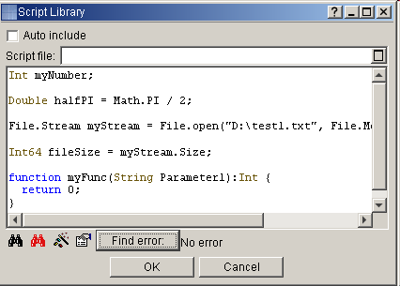
Scripting Basics Overview
Script - domain specific
  Targeted on printing
  String manipulation
Uses:
  Variables
  Object model
    Namespaces
    Methods
    Properties
  User defined functions

Slide 7

Scripting Basics Namespaces
Global – always available
Util – Utilities – lists of values
File – working with files
Math – Mathematics functions
ODBC – ODBC Databases
Workflow – Access to any workflow parameter
Workflow modules specific namespaces
    Path,FillStyle,Barcode
Notes:
The trainer will talk about these later…

Slide 8
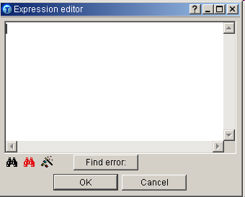
Scripting Basics Editor
Shortcuts:
CTRL+SPACE - displays all available objects, methods, etc.
CTRL+SHIFT+SPACE - displays hint for selected object, method, etc.
. - dot typed after an object or variable, etc. displays all methods, properties, etc. available for this “object”
^{Wizard}
Editor – write your code here
^{Script validator}
^{Search & replace}
Notes:
Tell the trainees to try it….

Slide 9
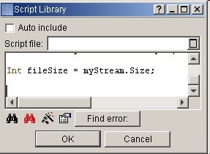
Scripting Basics Syntax
Java, C# based syntax
Each command should end with “;”
Case sensitive
Naming conventions Check syntax with “Find error” button
You can use the wizard
Read documentation!
Learn from examples
Notes:
Naming conventions – use meaningful names with no special characters. Name must not start with number.

Slide 10

Scripting Basics Keywords
If and if .. else conditional statements
For loop statement
While loop statement
Do .. while loop statement
Break statement – exiting loops
Continue statement – moving to next loop iteration
Goto statement – unconditional jump to defined label
Notes:
if and if .. else conditional statements, is construct
for loop statement – performs block of command x-times (specified by parameter
while loop statement – performs block of commands while condition is true
do .. while loop statement – performs block of commands once and then only if condition is true
break statement – exiting loops
continue statement – moving to next loop iteration
goto statement – unconditional jump to defined label – not really use it, because it may cause confusion
return statement – returns control to parent process and might return function value. Type must be same as defined in function declaration.
do.eval(Type,String)
static to declare static variables
function to declare functions
#use to use a a library

Slide 11
Scripting Basics Details
  Int – Integer type
  Currency – Fixed precision type
  Bool – Boolean value
  Double – Real type
  String – A string represents a sequence of characters.
  Char – Represents one character
  Array – structured type
Notes:
Int - Integer type; Range -2147483648..2147483647
Int64 - Integer type; Range: -2^63..2^63-1
Currency – Fixed precision type; Range: - 922337203685477.5808.. 922337203685477.5807
Bool - Boolean value is denoted by the predefined constants true and false.
Double – Real type; Range: 5.0 x 10^-324 .. 1.7 x 10^308
String - A string represents a sequence of characters.
Char – Represents one character (is coded in UNICODE – each character represents 2Bytes)
DateTime - is basically a real number of Double type, specifying the number of days passed since December 30st, 1899, 00:00:00.
Array – structured type each field can be accessed using index – ArrayName[index]; indexes starts with zero. Example: Array0[0].Field1 points to Field1 stored in first “row” of array – more in Input Script module.
Array0.Count
Util.StringList,Util.StringIntMap etc.

Slide 12
Scripting Basics Syntax
Operators
Arithmetic: +; -; *; /; %, ++, --
Binary operators: ~, &, ^, |
Boolean: not; and; xor; or
Comparsion: ==; !=; <; >; <=; >=
Assigning operators: =; +=; -=; *=
Using “ and ‘ characters
“Hello\x0Aworld” prints as: Hello\x0Aworld
‘Hello\x0Aworld’ prints as: Hello
world
Notes:
Operators
Arithmetic: +; -; *; /; % ... modulo
Other arithmetic: ++; -- (adds or subtracts 1)
Binary operators: ~ ... not; & ... and; ^ ... xor; | ... or
Boolean: not; and; xor; or
Comparsion: ==...Is equal to;!=...Not equal to;<...less than;>...greater than;<=...Less than or equal to;>=... Greater than or equal to
Assigning operators: =; +=; -=; *=
Using “ and ‘ characters – if you want to use “ in string it has to be enclosed in ‘ and vice versa. If special characters like \x0A(carriage return) are used then it is performed only when enclosed in ‘
“Hello\x0Aworld” prints as Hello\x0Aworld
and ‘Hello\x0Aworld’ prints as

Slide 13
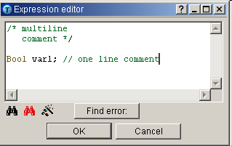
Scripting Basics Syntax
Comments:
One-line comment – starts with //
Multi-line comment starts with /* and ends with */
The best practice to create understandable code
Notes:
HelloWorld2.wfd
Numbers Input, if the number is even it is displayed along with the message ” – Even number”
The similar for Odd number
Using comments and strong names is the best practice to create easy understandable code not only for others but also for you if reading it after a period of time.

Slide 14
Scripting Basics Exercise
Create a new workflow with DataInput, Data Transformer and Layout
Create a scripted variable in Layout
If the number is smaller than one it has one decimal space
If the number is greater than one has one valid digit
Add two comments to the script telling the user the meaning of this script using // and also /* */
Notes:
Result at HelloWorld3.wfd
There is also an exercise with rounding numbers, etc.

Slide 15
2. Namespaces

Slide 16
Global Namespaces
LogMessage(String aMessage)
  Log a message
  Takes String as parameter
  <Any>.toString()
  Very useful when developing the scripts
All Types
  String
  DateTime
  Currency
LogError(String aMessage)
Notes:
Log message in Layout in any variable without any command “return”. This log message contains not just a string but also a variable converted to a string.
LogMessage.wfd
And others:
pauseAfterCurrentSheet(String aOperatorMessage)

Slide 17
Global Namespaces
Create a Workflow
Create a log message displaying current Date and Time
Create a variable displaying current Date and Time
Notes:
LogMessage2.wfd

Slide 18
Global Namespaces
String
  Your best friend
  .beginWith(String a)
  .contains
  Int
  Your next best friend
DateTime
  DateTime.Now
  .DayOfWeek
Double
  Int64,Currency
Notes:
GlobalNamespaces1.wfd

Slide 19
Util Namespace
Contains Classes for creating lists and maps
Each list has:
Add – method for adding value(end of list)
Size – Returns the size of the list.
Insert(index) – method for adding value(at specified index)
Clear – deletes all values from list
Remove – Removes a value from list index is parameter specified
Notes:
And other:
MyList[i]
resize - Resizes a list to the selected size. Involves either decreasing the number of items or increasing with zeros.
sort

Slide 20
Util Class Example
This example will add a few strings together, manipulate with them, resize the list and pad it with some string
Steps:
Add String “Hello ”
Add String “World!”
Insert String “Sample text: “
Remove “Hello “
Resize List to 10 - fill added with String “added”
Resize - List to 1 – deletes last 9 values
After each step print log message.
Notes:
UtilExample.wfd
And other:
MyList[i]
resize - Resizes a list to the selected size. Involves either decreasing the number of items or increasing with zeros.
sort

Slide 21
Util Class Exercise
Create a variable in Layout which
    Creates two strings
    Inserts a new string at the beginning of the util stringlist
    Displays those three strings together in one log message

Slide 22
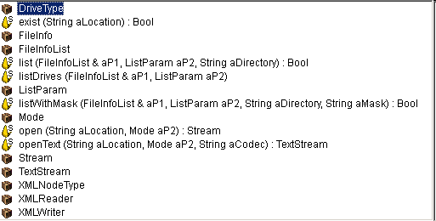
File Namespace
Enables the users to “read from” & “write to” files
Example – writing to file:
First line creates stream. Second line creates coded Text stream we use then for writing String into file. Finally streams are closed:
File.Stream s = File.open("D:\test1.txt", File.Mode.TruncateOrCreate);
File.TextStream ts = s.CodeTextStream["UTF-8"];
ts.writeString("This is the text I want to write into my text file.");
ts.close();
s.close();
Notes:
FileWrite.wfd

Slide 23
File Classes
Available classes:
FileInfo – Reading file information
FileInfoList – List of fileInfo objects
ListParam – List of Parameters
Mode – List of file modes used for opening stream
Stream – Binary stream
TextStream – Stream with coding specified
Notes:
And other:
DriveType – List of Drive-types
TextStream – Stream with coding specified
XMLNodeType – List of Node types
XMLReader – Object used for reading XML document
XMLWriter – Object used for writing to XML files.
Eval,ExecuteContext – execution,integration

Slide 24
Scripting Exercise
Create script which displays first line of any text file on your PC
Display its content in a Flow (using calculated variable)
Notes:
Script only in Layout

Slide 25
Resolution
Create calculated variable and add following code:
File.TextStream ts1 = File.openText("c:\autoexec.bat",File.Mode.ReadOnly,"UTF-8");
return ts1.readLine();
Use created variable in workflow
Notes:
FileRead.wfd

Slide 26
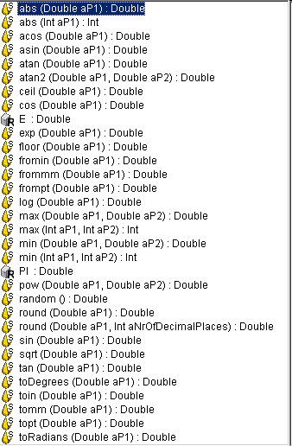
Math Namespace
Includes functions and constants
Description included in Help
Example – using PI:
function circumference(Double diameter):Double
{
return diameter * Math.PI;
}
Notes:
This function returns circumference of circle multiplying diameter (function parameter) and PI – math constant

Slide 27
Math Namespace Exercise
Create a workflow consisting of DataGenerator, Data Transformer and Layout
The incoming data is a Circle Area
In Data Transformer, create a variable calculating a radius of this Circle Area
Notes:
Radius.wfd

Slide 28
Accesing Modules Parameters
Used for accessing any parameter from workflow – during run-time.
ParamInput, DataAdd, Layout
Syntax:
WorkFlow.Parameter[String ModuleName, String Parameter]
Right click in SystemVariables to get it created
Propagated via Layout

Slide 29
Workflow Namespace Example
Command can be easily generated in layout:
Select Data -> System variables – RIGHT CLICK -> InsertParamVariable – all parameters listed there
Create a variable and enter the following text:
WorkFlow.Parameter["ParamInput1","test"];
Command from commandline: PnetTC.exe file.wfd –e PDF –parameterParamInput value
Notes:
WorkflowNamespace.wfd
It is possible to specify the parameter in command line, so this example is just for displaying default value of the parameter
The trainees will create a variable which will return the value of the parameter in ParamInput
The trainees will enter above mentioned commandline command corresponding to their Input File, ParamInput module and parameter, they will enter also a new value of this parameter.
WorkflowNamespace.wfd
Commandline: PNetTC.exe WorkflowNamespace.wfd -e PDF -testParams "This Is My Test"

Slide 30
ODBC
Used for database access
Various database types e.g. Microsoft Access, Excel, etc.
Notes:
Those files cannot be accessed in a different way…

Slide 31
3. Script Input Module

Slide 32
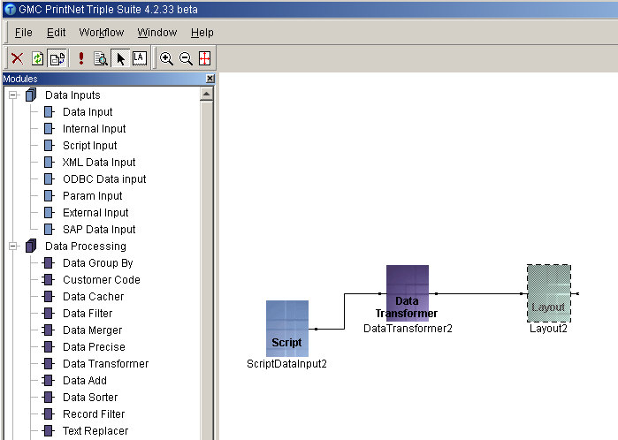
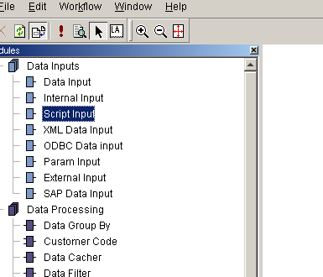
Script Input Module
Defines a script for reading and processing user defined input files
Notes:
Script Input Module can:
build a data structure
parse an Input file
add new variables to an existing data structure
and more...
It is a very powerful tool because the users can substitute all input modules by this module
E.G. if users try to access database files, or if there is different encoding for different parts of the file
Some input data may contain errors and they have to be corrected. This cannot be done by regular modules, so it is necessary to use ScriptInput module.

Slide 33
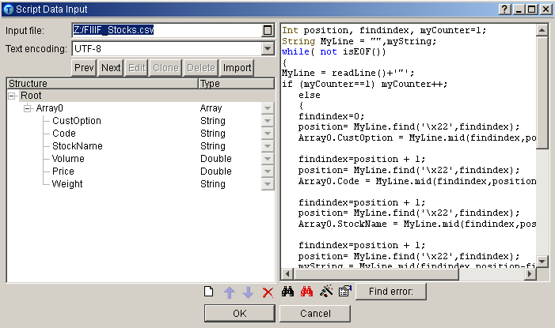
Handling Script Input Module
File name
Code page
Script editor
Data structure definition

Slide 34
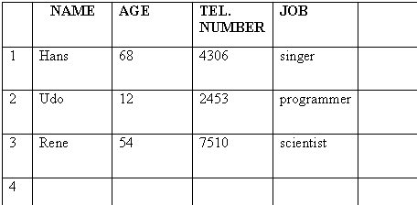
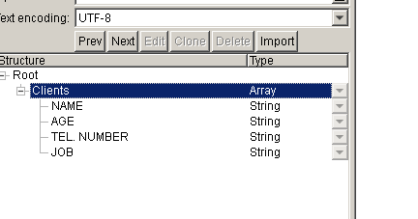
Building a Data Structure
Data structure creation
Arrays addition
Fields additions
data source
data structure
Notes:
ScriptInput.wfd
In Script Input you can build data structure according to your needs, in a structure building area you just add arrays and fields to decide on their relations.

Slide 35
Data Structure Exercise
Create a Workflow consisting of ScriptInput a Layout modules
In ScriptInput define a structure for the input file “Teams.csv”
Display the data in Layout
Notes:
ScriptInput2.wfd

Slide 36
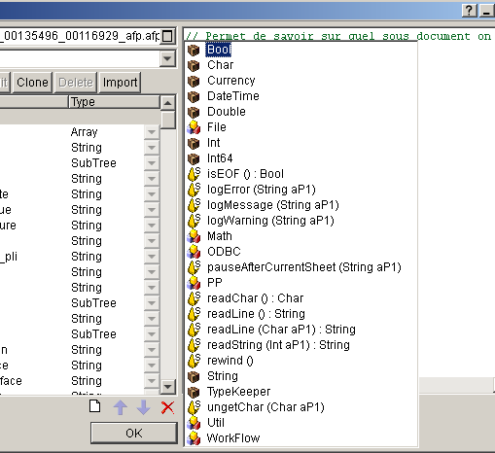
Parsing an Input File
Several methods:
ReadChar
UngetChar
ReadLine
ReadString
Rewind
IsEOF
Commit()
Notes:
Those are methods for reading a file

Slide 37
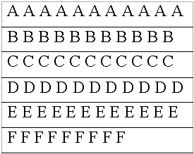
ReadChar Functionality
Used while parsing a file to read the next character from the current input file.
After each reading operation a new pointer position is saved. Next reading operation starts from this point.
pointer

Slide 38
UngetChar Functionality
Moves the position of the pointer one position backwards.

Slide 39
ReadString Functionality
Used while parsing a file to read the number of characters (specified by aP1 value - integer) from the current input file.
string length

Slide 40
ReadLine Functionality
Reading the characters until end-of-line character is reached
Used with parameter aP1
Notes:
Used while parsing a file to read the characters until end-of-line character is reached, from the current input file. When readLine is used without parameters, the character '\x0A' is used as end-of-line character by default. When readLine is used with parameter aP1 specified, it reads the characters until specified aP1 character is reached.

Slide 41
Rewind and IsEOF Funcionality
Resets the position of the pointer to zero (beginning of the input file)
The isEOF() function returns true only when the end of input file is reached
end

Slide 42
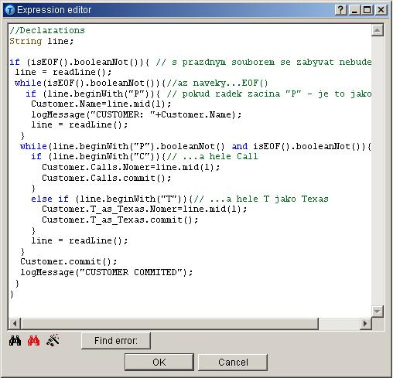
Commit () Command
New values addition to the fields
Submit each row to be stored permanently
It saves data and moves to next row
If multi-level structure, submitting for each level
Sub-array commit
Top – array commit
Notes:
Using the commit() command in conjunction with the array's field name you can add a new values to the fields. After data inserting you use this command to submit each row to be stored permanently. It saves data and moves to next row.
If you have multi-level structure submitting by commit(), command has to be done for each level; down – to – top order.

Slide 43
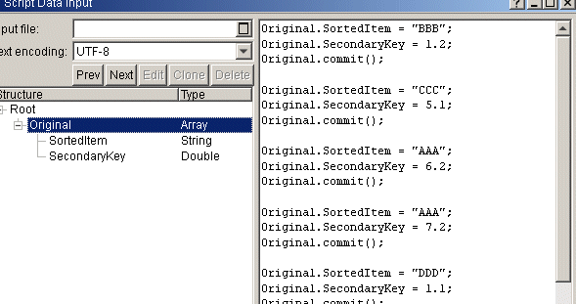
Other Features
Add a new variables or fields to an existing data structure
Add a new value to the field – for storing use commit command
Notes:
Rewind.wfd

Slide 44
Data Structure Example
Create a workflow consisting of Script Input module and Layout module
Use input file “Sample.csv”
The content of the file is read character by character
If the letter is capital it is displayed
Check the result in Proof
Notes:
ScriptInput3.wfd

Slide 45
Data Structure Exercise
Create a workflow consisting of Script Input module and Layout module
Use input file “Sample2.csv”
This file has some errors in it because there are some forbidden characters (“.” and “;” and “:”)
The content of the file is read character by character
Correct this file by script
Check the result in Proof
Notes:
ScriptInput4.wfd

Slide 46
ODBC Class
Database class – Represents database connected using ODBC
You can use ODBC Data input to generate string for you
Recordset class – Represents data returned by executing a query
StringList – List of strings
^{ODBC.Database db;}
db.connect("DBQ=D:\data\kurz.mdb;DefaultDir=D:\data;Driver={Driver do Microsoft Access (*.mdb)};DriverId=25;FIL=MS Access;FILEDSN=C:\Program Files\DataSources\kurz_test.dsn;MaxBufferSize=2048;MaxScanRows=8;PageTimeout=5;SafeTransactions=0;Threads=3;UID=admin;UserCommitSync=Yes;");
db.execute("drop table test"); //execute SQL command
db.disconnect(); //disconnect database

Slide 47
ODBC.Database class
Connect
CreateRecordSet disconnect
Error
Execute
IsError
ReadTablesInfo
Notes:
connect – connects to database using connection string( additional info on connection strings on internet - http://www.connectionstrings.com/
createRecordSet – creates recordSet executing SQL command
disconnect – closes connection
Error – property, where last error is stored
execute – executes SQL command without creating RecordSet
isError – check if command finished with/without an error
readTablesInfo – returns info for tables listed in list passed by parameter

Slide 48
ODBC.RecordSet class
BoolValue
ColumnCount
ColumnName
ColumnType
FetchNextRow
IntValue
Notes:
assign – Assigns recordset to current one
BoolValue – Converts an Integer to Boolean type
ColumnCount – Returns the column count.
ColumnName - Returns Column Name.
ColumnType – Returns the Type of given Column.
DateTimeValue - Returns DateTime value on the given index.
DoubleValue - Returns Double value on the given index
fetchNextRow - Reads values from the current line and moves to the next one. Returns true if new values were obtained, returns false at the end.
IntValue - Returns Int value on the given index.
isOpen - Returns true if RecordSet is open, otherwise returns false.
StringValue - Returns String value on the given index.

Slide 49
ODBC Example
This example will read a table from an XLS file
Then it will also calculate the average value
The whole table is displayed in Layout along with the average value
Notes:
ODBCread.wfd

Slide 50
4. Data Transformer Scripting

Slide 51
Data Transformer Agenda
  Data Transformer module:
  Usage of Data Transformer
  Variable context (Root for save, Array for save)
  Special fields
  Scripting of Data Transformer
  Exercise
Notes:
Data Transformer serves for data modification and future processing
It is possible to script in Data Transformer, create variables or perform calculations

Slide 52
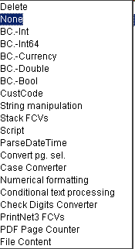
Data Transformer
Usage:
  BC. (basic conversion)
  String manipulations
  Stack FCVs
  CustomerCode
  ParseDateTime
  Create new (linked, unlinked, special) fields
  When no basic converter is sufficient then Scripted conversion (Customer code) is used.
Notes:
Usage
BC. (basic conversion) input data treated as strings into other data types
String manipulations (Concatenate strings, prefix+string+suffix)
Stack FCVs (field converters) (can be chained)
CustomerCode (to convert a value to an other output value) Each CustomerCode has one default value(the output string) that is applied if no predefined input strings match the actual data. If an input string matches the actual data, then that string is passed to the output.
ParseDateTime - (converts input data to an internal variable containing date and time values)
Create new (linked, unlinked, special) fields
When no basic converter is sufficient then Scripted conversion (Customer code) is used. The output string is determined as a result of the script.

Slide 53
Scripting in Data Transformer
  The same scripting options in Script Data Input or in Layout, syntax is similar to C++ syntax
  Used to convert input string to output by script
  Often used after a new variable creation in Data Transformer
Notes:
Used for variables preparations or data processing
In Layout, the scripting deals more with pages logic, overflows, etc.

Slide 54
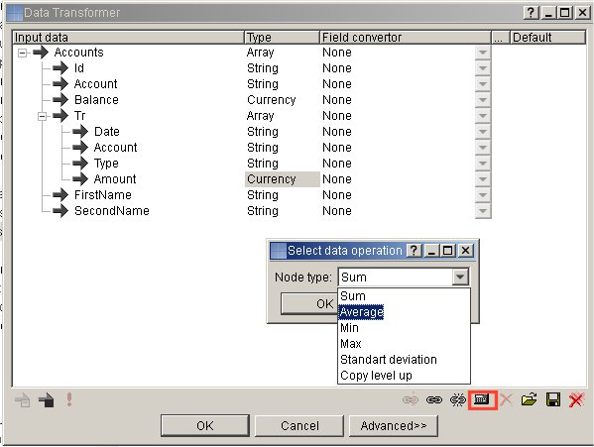
Script Tools in DataTransformer
Sum
Average
Min/Max
Standard deviation
Copy level up
Indexer Field
Notes:
An automatic supplement for scripting:
Sum - Creates a new field containing the sum of its parent field
Average - Creates a new field containing the average of its parent field.
Min/Max - Creates a new field containing the minimum/maximum value of its parent field
Standard deviation - Creates a new field containing the standard deviation (average squared deviation) of its parent field
Copy level up - Creates a new field which is copied to one level up. This field contains the original content.
Indexer Field – Determine index inside an Array

Slide 55
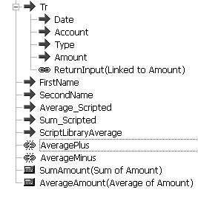
Script Tools in DataTransformer
Sum, Average, Min, Max and Standard deviation can be applied only to numbers (Int, Double, etc.)
Another way is to script the same function in scripted variable, then no Basic conversion is needed
Notes:
DataTransformerCalc.wfd
Sum, Average, Min, Max and Standard deviation can be applied only to numbers (Int, Double etc.), so you might need to use 2 Data Transformer modules – one for converting your String to Int, for example, and the second for creating this Special Field
Another way is to script the same function in scripted variable. Then, no Basic conversion is needed.

Slide 56
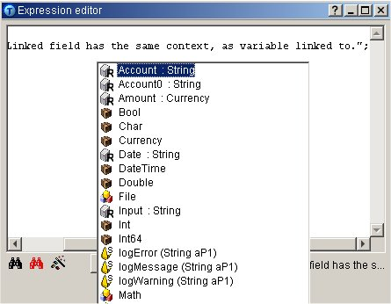
Script Tools in DataTransformer
Linked Field has the same context and content as original (if content not modified by script)
Unlinked field creates a new empty variable (usually use scripting)
Index Field - adds a new index field. It can be used in scripting or in Layout

Slide 57
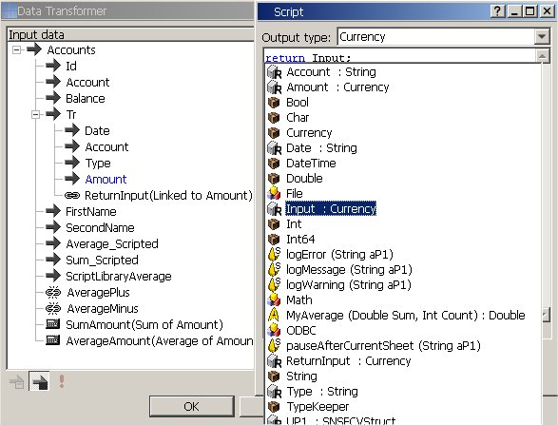
Script Tools in DataTransformer
The variable Input, (which appears, when you are using Linked field) returns the content of value, where it is linked to
Notes:
DataTransformerCalc2.wfd

Slide 58
Data Transformer Exercise
Create a simple workflow
Data Generator, Data Transformer and Layout modules
The number variable stands for circle radius
In Data Transformer create a variable which calculates a circle area
In Data Transformer create a variable which calculates a circle circumference
Notes:
DataTransformerCalc3.wfd

Slide 59
Mark Array/Root for Save
Speed considerations
Mark array for save – allows to access array structure from current array down to all sub-arrays
Mark root for save – access all records in all arrays in the Data Transformer
Notes:
Speed considerations
Mark array for save – Array marked by this option allows you to access array structure from current level variables (current array) down to all sub-array variables (all records of all sub-arrays). It saves just the sub-array(s) structure of the current record
Mark root for save – When you check this option then you have possibility to access all records in all arrays in the Data Transformer. This feature is of course more performance consuming. It saves all arrays structures within the Data Transformer

Slide 60
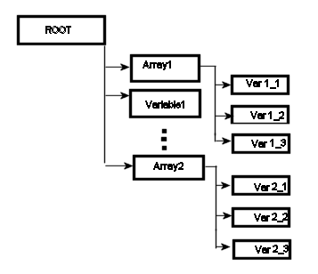
Mark Array/Root for Save
Need to use Var 2_1 in Var 1_2 – Mark Root for save
Need to access any variable from Array 1 – Mark Array1 for save
Notes:
If I need to use variable Var 2_1 in variable Var 1_2, it is necessary to use Mark Root for save. All subarrays of ROOT will be accessible then.
If I don’t need to access any variable from Array 2 in variables from Array 1, I can check Mark Array1 for save and only Var 1_x will be accessible to each other.

Slide 61
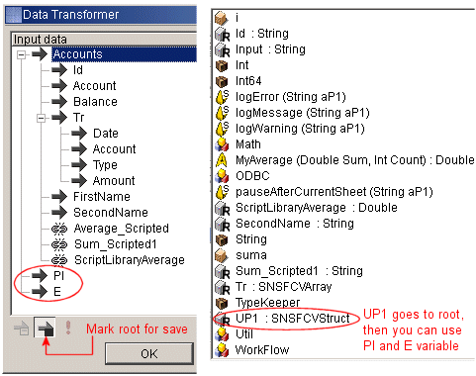
Root for Save
To access variables PI and E from Accounts array:
  It is necessary to use Mark Root for save
  Then use UP1.PI for access PI variable or UP1.E for access E variable

Slide 62
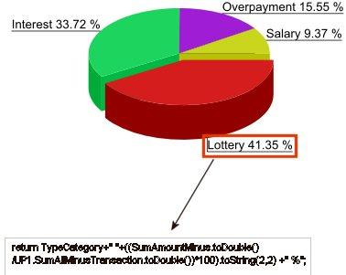
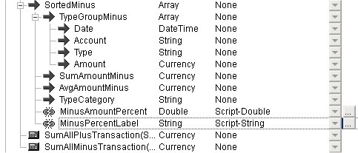
Root for Save Example
Notes:
return TypeCategory+ “ “ +((SumAmountMinus.toDouble()/UP1.SumAllMinusTransaction.toDouble())*100.toString(2,2)+ “ %”;
If you need labels for graph and you do not have convenient data, you must script it yourself. On this example, you can see how to connect strings.

Slide 63
Scripting Exercise
Use Tr.xml input file
Calculate the average of Transactions amounts by script in Data Transformer
Calculate the sum of Transactions amounts by script in Data Transformer
Verify the amount by a function Avg and Sum
Notes:
DataTransformerCalc4.wfd

Slide 64
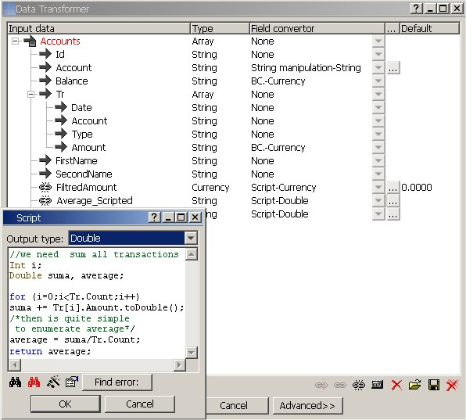
Scripting Exercise
It is possible to use only one dataTransformer because conversion to Double or Currency is not needed
Notes:
toDouble converts Amount to type Double.
For cycle goes through all transactions of one person and adds values to variable suma.
Tr.count means count of transactions of one person.

Slide 65
5. Layout Scripting

Slide 66
Layout Scripting
  Select By
  Kinds of variables in Layout, repeated rowsets,flows
  Scripting Variables
  Global Variables
  System Variables
  ScriptObject
Notes:
In Layout, scripting serves for pages logic, overflowing and other topics which cannot be replaced by DataTransformer scripting

Slide 67
Layout Scripting
No long scripts are usually necessary
We can do similar things in Layout as in Data Transformer.
Sometimes it is more effective to script in Data Transformer (the script is interpreted only once)
Sometimes it is better to script it in Layout (script is interpreted each time, when scripted variable is used)
It depends on script type
Notes:
Variable can be placed to Data, Rowsets, Flow node

Slide 68
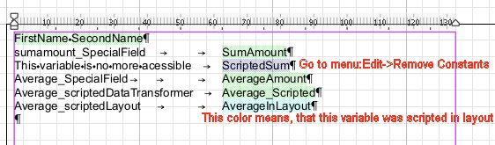
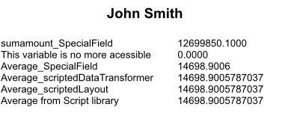
Scripting in Layout Variables
Proof

Slide 69
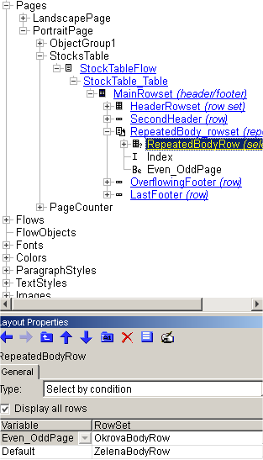
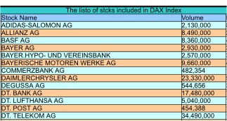
Scripting in Layout Rowsets
We can use variables in different contexts, e.g. in rowsets
Useful for deciding if row in table is even or odd and according to result we use different color for row
Notes:
If we have repeated rowset, System variable Index is always accessible on its context.

Slide 70
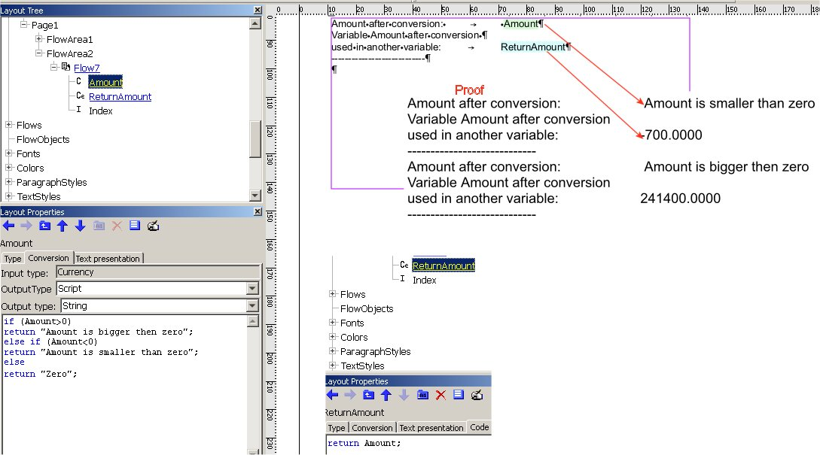
Layout Scripting
You can modify the variable in Conversion Tab.
Modified only in layout. When you use the same variable in another variable, it returns its original value.
Notes:
Apostroph – special character \x0d is interpreted.
Quotation marks do not interpret special characters

Slide 71
Layout Scripting Exercise
Create a simple Workflow consisting of a Data Generator and Layout
In Layout create a table which contains the values from Data Generator
Each Odd row will be red
Each Even row will be green
Notes:
Layout.wfd

Slide 72
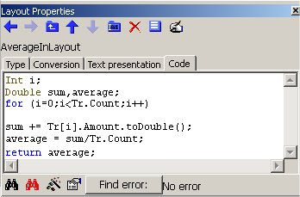
Layout Scripting Variables

Slide 73
Layout Scripting Global Variables
Modification and storage of a variable within one page, one record or whole job
  Global variables are read/write variables
  Can be used to store data within one page, one record
  Support rollback in PageSelection
  Can only be used in Layout
Static variables
  Anywhere in WorkFlow
  No rollback
Notes:
Using global variables you can modify and remember a variable within one page, one record or whole job.
It can e.g. remember whether there was overflow on the first page, what is the total spending or earning of an individual, etc.
global variables are read/write variables
can be used to store data within one page, one record
Two approaches to use global variables
Support rollback in PageSelection
Can only be used in Layout
static variables
Anywhere in WorkFlow
No rollback

Slide 74
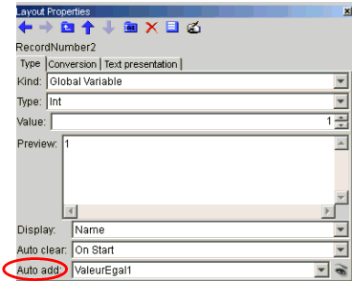

Global Variables Approach 1
Store data to be remembered within records - use Auto add “Number" variable
Place the “Number" variable into the Flowarea with the option "Flowing To next page“
Every time FlowArea is printed, the global variable “Sum" is incremented
Notes:
Layout2.wfd
If you want to use global variable "RecordNumber2" to store data to be remembered within records than you can use Auto add "ValeurEgal1" variable
You have to place the "ValeurEgal1" variable into the FlowArea and set the Flowarea with the option "Flowing To next page“
Every time FlowArea is printed, the global variable "RecordNumber2" is incremented by the content of the variable "ValeurEgal1

Slide 75


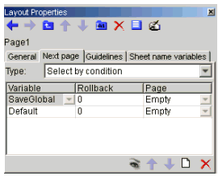
Global Variables Approach 2
Create the RecordNumber2 Global Variable
Create the SaveGlobal Boolean Variable
Use SaveGlobal variable in Next page condition
Notes:
Layout3.wfd
How it works:
Each time PrintNet T checks Next page conditions the SaveGlobal variable is processed (it returns false and it means that only RecordNumber2 Global Variable is incremented)
Result of RecordNumber2 modification can be used later in other records of the job

Slide 76
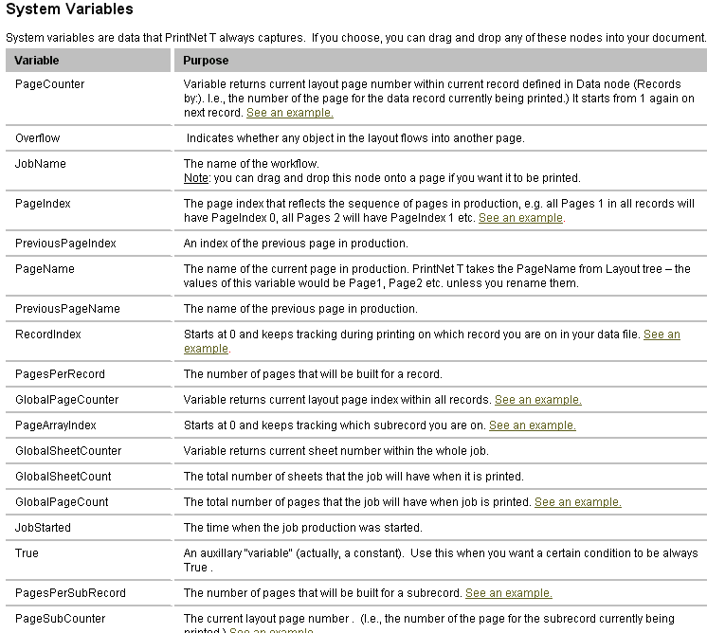
Layout Scripting

Slide 77
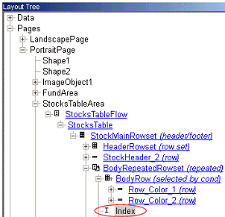
System Variables Index
  Flow or Rowset repeated by an Array
  The variable Index displays the index (begins from 0)
Notes:
Index.wfd
If you set a Flow or Rowset to be repeated by an Array coming from the data there is a system variable Index created.
The variable Index displays the index (begins from 0) of the current variable field coming from the Array by which the Flow or Rowset is repeated when such field is used within the repeated Rowset or Flow.

Slide 78
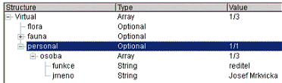
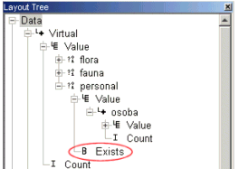
System Variables Exists
Type in data defined as Optional.
It returns true in case there is a value coming to the data
Notes:
There is a system variable Exists if the Type in data is defined as Optional. (Optional means that a value can appear there 0 or 1 times.)
It returns true in case that there IS a value coming to the data
This variable can be useful for e.g. scripting and also for flows and rowsets selected by condition – if Exists, display an appropriate flow or rowset

Slide 79
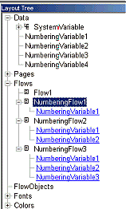
Numbering Variables
Possibility of numbering variables, for structuring the text
Numbering variables appear in Data node as new, automatically created variables
There is no scripting, but it is a variable
Notes:
We can use numbering variables, when we need to structure our text.
Numbering variables appear in Data node as new, automatically created variables and in Flows node where you can see where they are actually used.
There is no scripting, it is mentioned in scripting training presentation, because it is variable

Slide 80
Variable Formatted Flow
Flow content and formatting can be controlled by variables
To control the flow content and formatting:
    Select the flow you want to control.
    From the Flows Layout Properties Dialog, select Variable Formatted as the flow type
Assign a (string) variable to the flow that will control the formatting.
Notes:
It is possible to create a script which will insert a table which row height will be variable

Slide 81
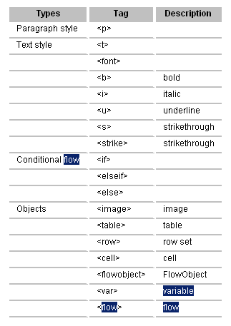
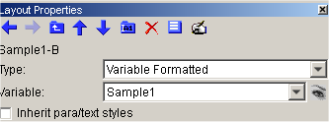
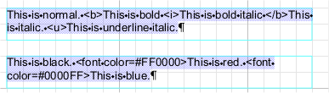

Variable Formatted Flow
Tags, you can use, are listed below. For more information see helpfile (search „Variable formatted flow“)
Notes:
VariableFlow1.wfd
Tags, you can use, are listed below. For more information see helpfile (search „Variable formatted flow“)

Slide 82
Variable Formatted Flow Exercise
Create a workflow
Use Teams.csv input file
Create a variable which controls a flow and which displays the ID, name and surename of team members
Notes:
VariableFlow2.wfd

Slide 83
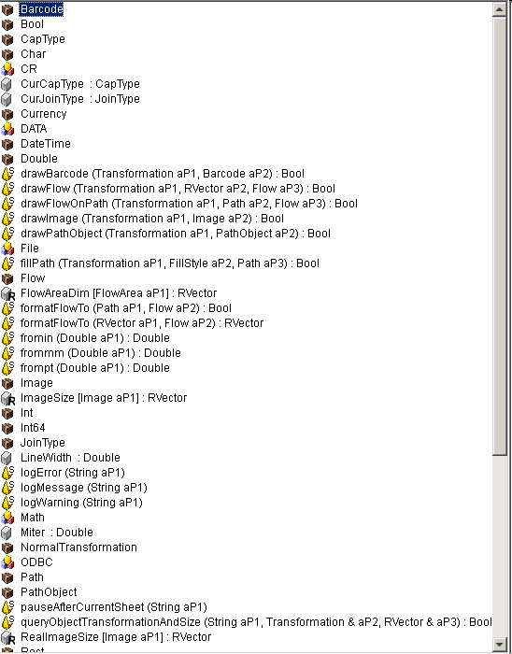
Layout Scripted Object
Scripted objects enable you to apply transformations
Can work with:
  Images
  Barcodes
  Flows
  etc.
Notes:
Scripted objects enable you to apply transformations (copying, moving, dimensioning, transposition) to the existing layout objects and to create new objects from within the script.
Can work with:
Images
Barcodes
Flows
etc.

Slide 84
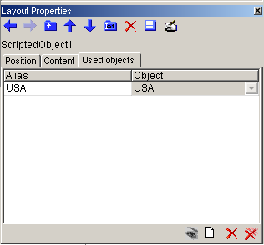
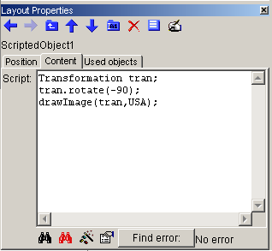
Layout Scripted Object
  How to:
  Draw Scripted object in Layout (use in the left menu in Layout)
  Use objects tab – setting reference to existing layout objects
  Content tab – writing script code

Slide 85
Layout Scripted Object Classes
BarCode
Image
Flow
PathObject- used to draw shapes defined in Layout
Path – used to create shapes
Transformation – used for objects transformations
And others...
Notes:
BarCode, Image, Flow, PathObject - allow to create instance of object by assigning instance of layout object mapped through “used objects”

Slide 86
Layout Scripted Object Methods
DrawBarcode()
DrawFlow()
DrawFlowOnPath()
DrawImage()
DrawPathObject()
FillPath() – fills the shape using FillStyle
Others – formatting and overflow checking methods, etc.
Notes:
Methods for drawing objects in Layout using object reference, transformation and additional parameters (if required)

Slide 87
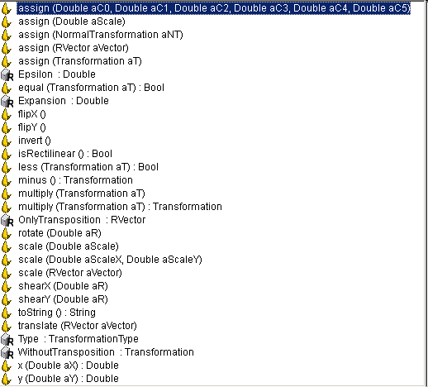
Transformations
Using Transformation matrix
Units – meters, degrees
Flipping, scaling, moving,
rotation, shearing
Transformation myTran; // create Transaction object
myTran.rotate(-90); // adds rotation to Trans. matrix
myTran.scale(0.5,0.5); // adds scaling to Trans. matrix
myTran.translate(RVector(0,Math.frommm(105))); // adds moving
myTran *= myTran2; //Combining two transformations
Notes:
ScriptedObject.wfd
ScriptedObject1.wfd

Slide 88
Scripted Object Exercise
SOExampleImage-Empty.wfd – use scripted object in it
Condition based on RecordIndex
Transformations
Required Output is ScriptedObject1.pdf
Resolution is in SOExampleImage.wfd
Notes:
Show the trainees sample job: clock.wfd, clock4.5.wfd Kalender_2006.wfd

Slide 89
6. Impositioning Script

Slide 90
Impositioning Script
Working with sheets:
  Output segmentation .GroupBegin
  Statistics
  Multiple inputs
  Multiple outputs
  Page transformations
    Rotation
    Resizing
    Moving
Notes:
Working with sheets
Output segmentation .GroupBegin
Statistics
Multiple inputs
Multiple outputs
Page transformations
Rotation
Resizing
Moving
To perform what is not already implemented(hard-coded functions may be faster)

Slide 91
Impositioning Script
INPUT / OUTPUT – sets
  SheetInfo – represents whole sheet(one from set)
    LogPage – represents single sheet layer
    SheetName[index] – access to SheetName variables
INPUT/OUTPUT
SheetInfo[0]
SheetInfo[1]
SheetInfo[2]
LogPage[0]
LogPage[0]
LogPage[0]
LogPage[1]
LogPage[1]
LogPage[1]
LogPage[2]
LogPage[2]
LogPage[3]
SheetName[index]

Slide 92
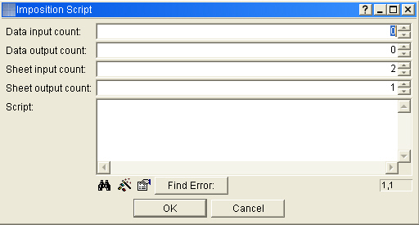
Impositioning Script
Data input
Data output
Sheet input
Sheet output
Sheet output

Slide 93
Impositioning Script
Input
Output
Transformation
SheetInfo
    InputSheeter[0].SheetInfo[0] - First sheet from first input
    OutputSheeter[0].addSheetInfo(SheetInfo)
    Adding sheet to first output.
LogPage
SheetName
    OutputSheeter[0].SheetInfo[0].SheetName[0] = value
Notes:
INPUT - InputSheeter[index] index starting at 0,SheetCount
OUTPUT - OutputSheeter[index] index starting at 0, SheetCount
Transformation class – used to rotate, scale, move, flip sheets, etc. Transformations are counted using Transformation matrix(more on internet).
SheetInfo – Represents whole sheet (multilayer)
InputSheeter[0].SheetInfo[0] – means first sheet from first input.
OutputSheeter[0].addSheetInfo(SheetInfo) – adding sheet to first output.
LogPage – Represents one layer of a sheet
InputSheeter[0].SheetInfo[0].LogPage[0]
SheetName – Access to SheetName variables
OutputSheeter[0].SheetInfo[0].SheetName[0] = value

Slide 94
Impositioning Script Input
InputSheeter[index]
for(Int i=0;i<InputSheeter[0].SheetCount;i++) // cycle through all input sheets
{
mySheet = InputSheeter[0].SheetInfo[i]; //returns sheet index=i
//performed actions
}
InputSheeter[index].SheetCount
InputSheeter[index].SheetInfo[index]
InputSheeter[index].SheetInfo[index].SheetName [index]
Notes:
InputSheeter[index] – array of inputs
InputSheeter[index].SheetCount – number of sheets
InputSheeter[index].SheetInfo[index] – reference to sheet
InputSheeter[index].SheetInfo[index].SheetName [index] – reference to SheetName variable (Read Only)

Slide 95
Impositioning Script Output
OutputSheeter[index]
for(Int i=0;i<InputSheeter[0].SheetCount;i++) //cycle through input sheets
{
OutputSheeter[0].addSheetInfo(InputSheeter[0].SheetInfo[i]);
//adds sheet from input to output
}
OutputSheeter[index].SheetCount
OutputSheeter[index].SheetInfo[index]
OutputSheeter[index].addSheetInfo(SheetInfo) OutputSheeter[index].SheetInfo[index].SheetName [index]
Notes:
OutputSheeter[index] – array of Outputs.
OutputSheeter[index].SheetCount – number of sheets
OutputSheeter[index].SheetInfo[index] – reference to sheet
OutputSheeter[index].addSheetInfo(SheetInfo) – adds sheet to output array
OutputSheeter[index].SheetInfo[index].SheetName [index] – reference to SheetName variable (Read/Write)

Slide 96
Impositioning Script Sample
Simple Workflow
Data Generator, Layout, Impositioning Script, Output module
Simply takes sheets from Layout and send them to the Output
Notes:
Impositioning.wfd

Slide 97
Impositioning Script Exercise
Simple Workflow
Data Generator, two Layout modules, Impositioning Script, Output
Join the Layout modules into the Impositioning module
Take sheets from both Layouts and send them to the Output first from the first Layout module and then from the second one
Create second possibility where you mix the sheets from both Layouts
Notes:
Impositioning1.wfd
Impositioning2.wfd

Slide 98
Impositioning Script Examples
Two Layouts
Add both of them to one page
Two Layouts
The second SheetName in both Layouts will be connected to a static variable with some value (e.g. 1,2,..) stored in it
We can call this value Mail cost
The value is different in both Layouts
At the end we connect these Layouts together and calculate the mail cost which will be stored in a TXT file
Notes:
Impositioning3.wfd

Slide 99
Impositioning Script Example
Data Generator, two Layouts
First Layout contains numbers from the Generator which overflow to the next page
After every even page there is a commercial page inserted
Notes:
InsertingSheets.wfd

Slide 100
Impositioning Script
Transformations:
Using Transformation matrix
Units – meters, degrees
Flipping, scaling, moving, rotation, shearing
Transformation myTran; // create Transaction object
myTran.rotate(-90); // adds rotation to Trans. matrix
myTran.scale(0.5,0.5); // adds scaling to Trans. matrix
myTran.translate(RVector(0,Math.frommm(105))); // adds moving
OutputSheeter[0].SheetInfo[i].LogPage[0].transform(myTran);
// perform transaction on specified sheet

Slide 101
Impositioning Script Example
One Layout module containing an image
Through Impositioning module rescale the sheet, rotate the page and translate it
Notes:
Impositioning4.wfd

Slide 102
Impositioning Script Exercise
Create a workflow consisting of two Layout modules, Impositioning and Output
Each Layout module contains an image
The Impositioning module will simply copy sheets from the first Layout module and copy transformed sheets from the second Layout module
This transformed image should be rotated, rescaled and transformed
Check your output
Notes:
Impositioning5.wfd

Slide 103
Sheet Statistics
Data file which contains Sheet or Page info
This file is typically used to re-process the original data file into a postal rate optimized file
Set in the workflow directly after the Layout module for which you want to gather statistics
Notes:
Statistic.wfd
Sheet name 1 If checked, information included for Sheet name 1.
Sheet name 2 If checked, information included for Sheet name 2.
Page count If checked, provides page counts.
Sheet count If checked, provides sheet counts.
Page Align - CharWidthReserves the number of characters in CharWidth field for the page count.
When set to 5 the number will be left padded with zeros (00001).
Sheet Align - CharWidthReserves the number of characters in CharWidth field for the sheet count.
When set to 5 the number will be left padded with zeros (00001).
Group beginsWhen checked, a special field is added to the end of each line indicating, whether the current sheet is the first sheet of the group (i.e. group begins with this sheet). When this is the 1st sheet, it is 1, otherwise it is 0.SeparatorThe character PrintNet T will use to divide fields in a CSV output log file.

Slide 104
Statistic Data
Prepares sheet information according to various criteria
Create data for Layout
Create specifically formatted data, or propagate all sheet information for scripting (i.e., Sheet Info).
Contain data for the whole job generated when running Proof of Production.
Notes:
The Sheet Statistics Data module can do the following:
Prepare sheet information according to various criteria for banner pages.
Create data for Layout (usually based upon output of another Layout).
Create specifically formatted data, or propagate all sheet information for scripting (i.e., Sheet Info).
Contain data for the whole job generated when running Proof of Production.
For more information see:
StatisticDataModuleTrainingMaterial.doc
StatisticData.wfd

Slide 105
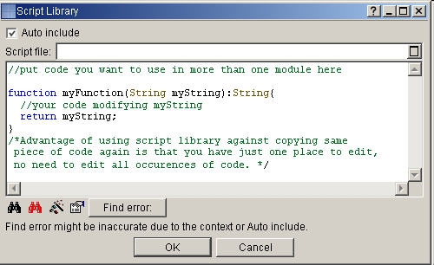
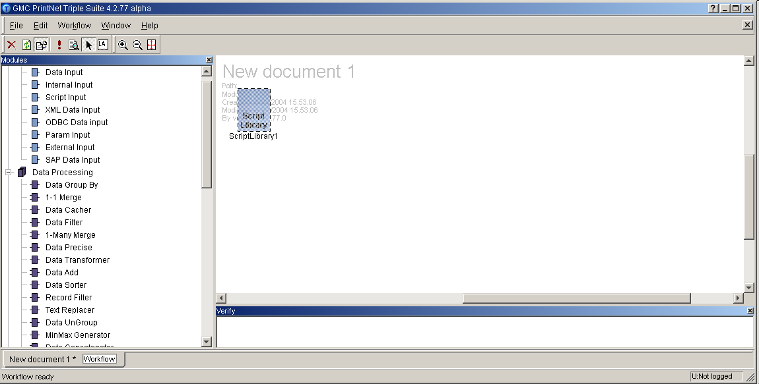
ScriptLibrary
Notes:
Script Library Module is for storing custom function definitions (shared across the workflow). The module can be stored as external or internal. The Script Library Module does not have any input or output connectors, it is just a container placed in the wfd allowing the use of saved functions in any scripts
Auto Include
When checked, functions from the included scripts can be called from any script within the workflow and are offered after pressing Ctrl+Space in the script dialog.
When Auto include is not checked, you will have to use “#use” keyword instead in order to use any predefined function.
Once you enter it in the script edit box, the Script Library becomes available for the current module and you can select your functions after pressing Ctrl+Space. The keyword is used in this format: #use YourScriptLibraryName
Example: #use ScriptLibrary1;

Slide 106
ScriptLibrary Example
In ScriptLibrary Module there is one function created
This function is of a type double and calculates area of a circle
This function is auto included so there is no need to use “#use” command
Notes:
ScriptLibrary.wfd

Slide 107
ScriptLibrary Exercise
Create a function which takes a number and returns its cubed value
Use Script Library module
Check the result
Notes:
ScriptLibrary1.wfd

Slide 108
Scripting Tricks
Static variables
ScriptDataInput module
Static Int a;
Int a=5;

Slide 109
Scripting Tricks
Encoding an array into String:
String s=“Monday|Tuesday|”;
Int cnt=s.countOccurences(‘|’);
for(Int i=0;i<cnt;i++)
{
logMessage(s.Part[i,’|’]);
}
Notes:
Trick.wfd

Slide 110

Any questions? Thank You.

